Slide 1
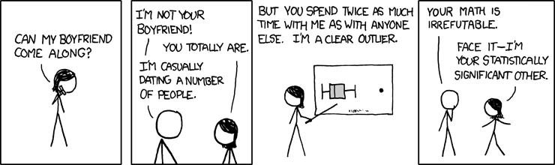
Hypothesis testing and one sample parametric tests
XKCD
Geog4300/6300
Jerry Shannon

Slide 2
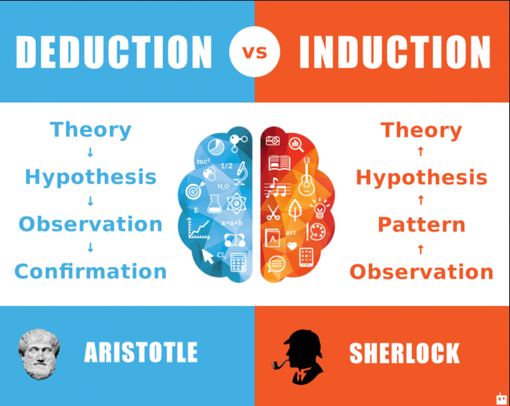
Hypothesis testing:
Follows a deductive mode of reasoning
Notes:
Alternative hypothesis is usually what you’re trying to prove.

Slide 3

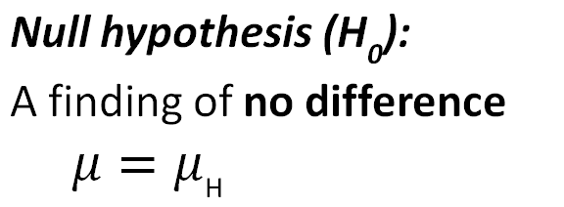
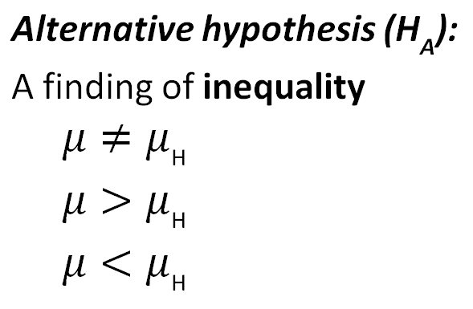
Ingredients of classical hypothesis testing
Notes:
Alternative hypothesis is usually what you’re trying to prove.

Slide 4
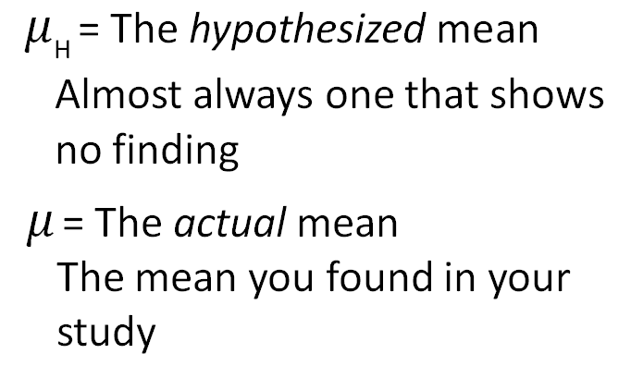
Ingredients of classical hypothesis testing

Slide 5


Did higher fuel efficiency standards improve
the Air Quality Index in Los Angeles?
(a hypothetical)
Prior to the increase, air quality readings averaged 107.
What’s the hypothesized mean?

Slide 6

Did higher fuel efficiency standards improve
the Air Quality Index in Los Angeles?
(a hypothetical)
What are the null and alternative hypotheses?

Slide 7

The OJ Simpson trial
Did he really do it?
What was the verdict?
Notes:
What’s the difference between these two questions?
One is known, the other is unknown.

Slide 8




Did OJ really do it?
What was the verdict?
 | The true situation (unknown)
Jury decision | He did it | He didn’t do it
Guilty
Not guilty
Which two outcomes are errors?

Slide 9
Type I and Type II errors
False positive (Type I Error)
 | The true situation (unknown)
Our statistical test | Null is false | Null is true
Reject the null hypothesis
Accept the null hypothesis
How confident are we that we are avoiding these errors?
We said there is a difference but there’s not
There really is a difference
There is a difference but we didn’t find it
There really is no difference
False negative (Type II Error)

Slide 10
False positives and negatives
False positive: We said there is a difference, but there’s not. Confidence measured with significance level (α). Usually 0.05, 0.10, or 0.01.
False negative: There is a difference, but we didn’t find it. Likelihood of error is expressed as the power (1-β). Can be adjusted by changing alpha or increasing sample size.

Slide 11


Slide 12
What is a “parametric test”?
One where you assume the data is normally distributed.
Non-parametric tests transform the data in order to calculate a test statistic.

Slide 13
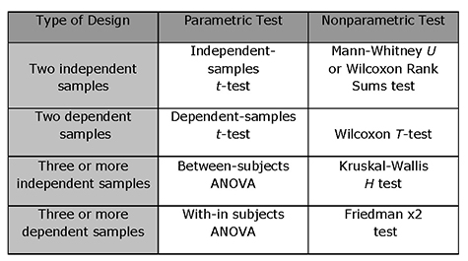

Slide 14
Hypothesis testing: standard procedure
State the null and alternate hypothesis
Select appropriate statistical test
Select level of significance
Identify the rejection region of the null hypothesis
Calculate test statistic
Make decision regarding null and alternative hypothesis

Slide 15

1) State the Null and Alternate hypotheses
H₀ = No finding—what we would expect to see
H_{A} = Significant finding of difference from expected value

Slide 16
2) Select the appropriate statistic
Variables | Tests; test statistics; SE
Continuous; one sample: σ known and n > 30 OR data is a proportion | One-sample z-test; Z; SE = σ/sqrt(n); OR Diff. of proportions
Continuous; one sample: σ unknown or n < 30 | One-sample t-test; t; SE = s/sqrt(n-1)
Continuous; two samples | Student’s t-test for difference of means
Continuous; paired samples | Paired t-test
Continuous; more than two samples | ANOVA
Discrete; two variables; counts | Chi-square, goodness of fit
Continuous; two or more variables | Regression

Slide 17

3) What’s the level of significance
How much confidence do you want in your result? This is the “alpha.”
Most common alphas: 0.10, 0.05, 0.01

Slide 18

4) Identify the rejection region of the null hypothesis
Is your test one tailed or two tailed?
Example of one tailed test:
Is this year hotter than last?
Example of two tailed test:
Has the obesity rate changed in the last year?
Notes:
Compare null and alternative hypotheses for each

Slide 19
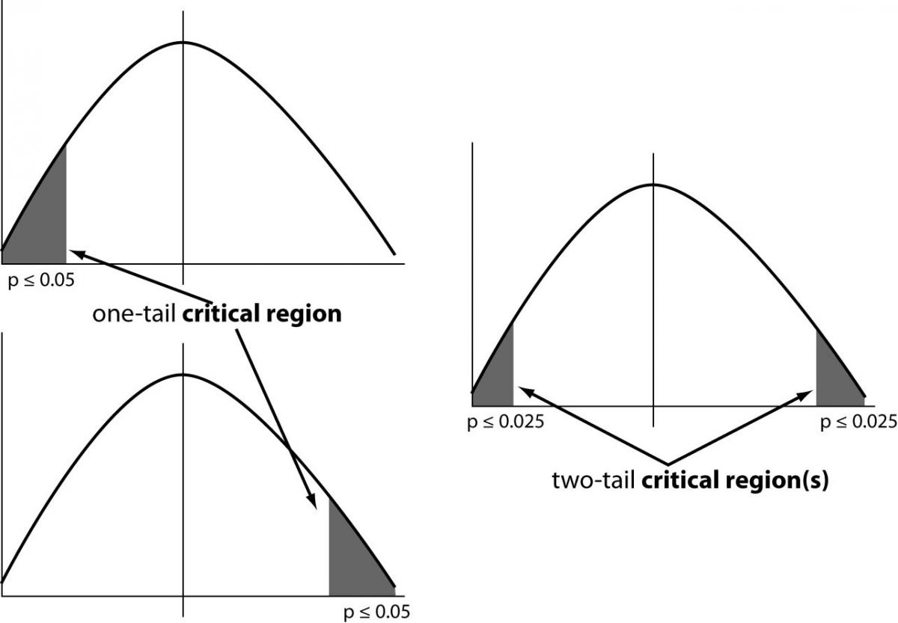
Is your test one tailed or two tailed?
Notes:
Critical region=Area of the rejection of the null hypothesis

Slide 20
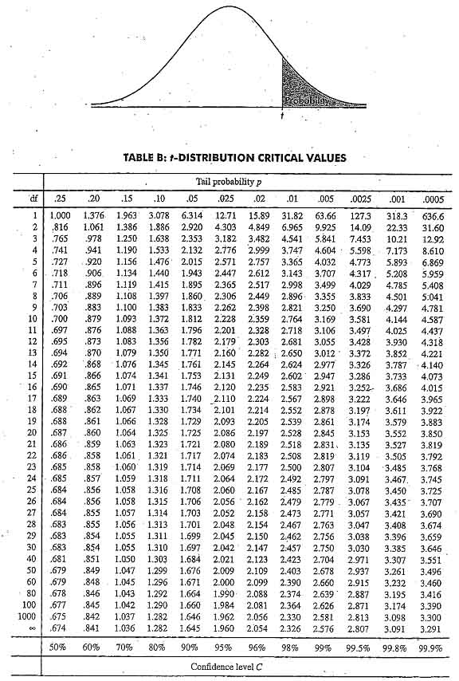

5) Calculate test statistic
Each test has a
different statistic:
t, z, F, W…

Slide 21
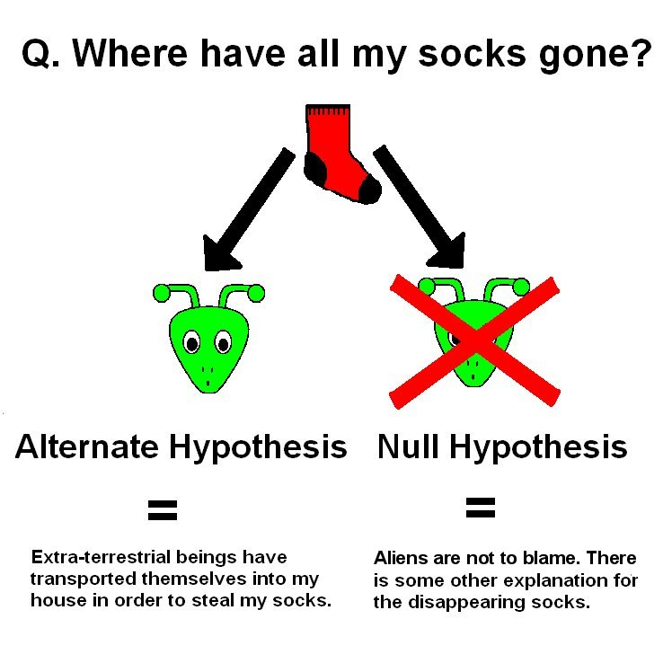
6) Make decision about null and alternate hypothesis

Slide 22
One sample test
Used to compare a sample to known population
Was this year hotter than average?
Are the poverty levels in a neighborhood different from the citywide average?
Do states with higher welfare enrollments have lower rates of crime than the national average?
Key assumptions
Normality
Statistical independence
(Sometimes) Known variance

Slide 23
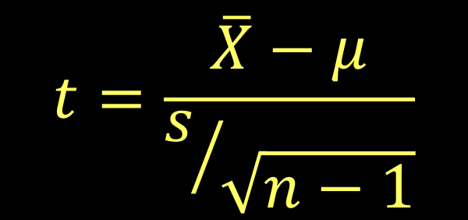
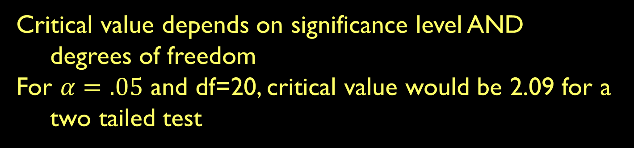
T test: when s.d. is unknown OR n <30
Example: When collecting pilot data for a new research question
Standard error for a t distribution

Slide 24
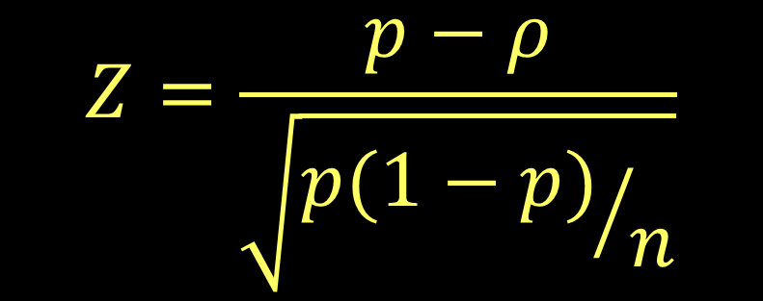
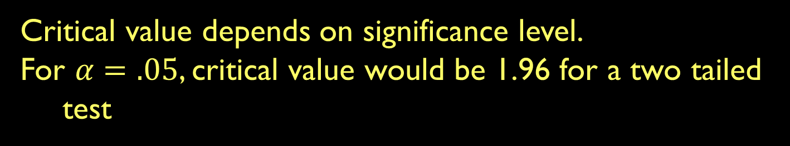
One sample difference of proportions
Example: When collecting pilot data for a new research question
Proportions use a Z score

Slide 25

An example:
A recent survey shows that Americans watch 25 hours a week of streaming video. We interviewed 85 UGA students and found that they watched 19 hours a week of video (with a sample standard deviation of 3.2). Do UGA students differ in their viewing habits from the American population?

Slide 26
1) What’s the null and alternate hypothesis?
A recent survey shows that Americans watch 25 hours a week of steaming video. We interviewed 100 UGA students and found that they watched 19 hours a week of video (with a sample standard deviation of 3.2). Do UGA students differ in their viewing habits from the American population?
H₀: UGA video watching = 25 hours/week
H_{A}: UGA video watching ≠ 25 hours/week

Slide 27
2) Select the appropriate statistic
Variables | Tests; test statistics; SE
Continuous; one sample: σ known and n > 30 OR data is a proportion | One-sample z-test; Z; SE = σ/sqrt(n); OR Diff. of proportions
Continuous; one sample: σ unknown or n < 30 | One-sample t-test; t; SE = s/sqrt(n-1)
Continuous; two samples | Student’s t-test for difference of means
Continuous; paired samples | Paired t-test
Continuous; more than two samples | ANOVA
Discrete; two variables; counts | Chi-square, goodness of fit
Continuous; two or more variables | Regression

Slide 28
3) Select the level of significance
We would like 95% confidence in our result.
One tailed or two tailed test?
Our null hypothesis is
UGA video watching = 25 hours/week
This is a two tailed test.
Does our sample mean fall within the range of expected sample means given the population?

Slide 29
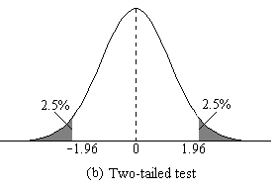
4) Identify the rejection region
For a t test with d.f.=99 and 95% confidence, the critical value is 1.98/-1.98
-1.98
1.98

Slide 30
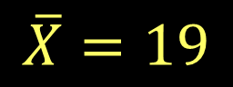
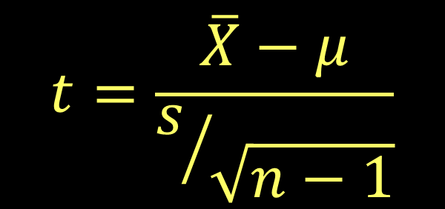
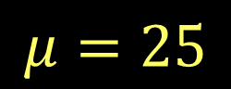
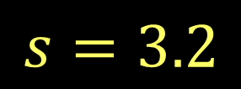
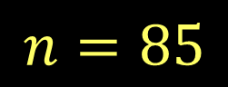

5) Calculate the test statistic

Slide 31

6) Make decision about the alternate/null hypotheses
Does UGA get a rose because students watch more or less video than the national average?

Slide 32

YES! The t statistic of -17.19 is lower than our critical value of -1.98. The null hypothesis is rejected.
We can say with
95% confidence
that UGA students
Have different viewing habits than
the nation as a whole.

Slide 33

Another example:
Does Athens, GA have more dogs than
the national average? You survey 50 households.
The Humane Society estimates that 47% of all U.S. households have one dog.
1) What are the hypotheses?
H₀: Athens dog ownership ≥ 47%
H_{A}: Athens dog ownership < 47%

Slide 34
2) Select the appropriate statistic
Variables | Tests; test statistics; SE
Continuous; one sample: σ known and n > 30 OR data is a proportion | One-sample z-test; Z; SE = σ/sqrt(n); OR Diff. of proportions
Continuous; one sample: σ unknown or n < 30 | One-sample t-test; t; SE = s/sqrt(n-1)
Continuous; two samples | Student’s t-test for difference of means
Continuous; paired samples | Paired t-test
Continuous; more than two samples | ANOVA
Discrete; two variables; counts | Chi-square, goodness of fit
Continuous; two or more variables | Regression

Slide 35
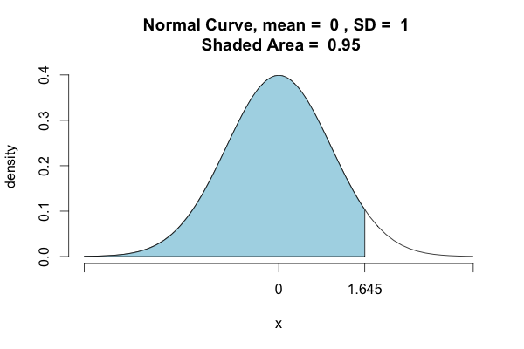
3) Select the level of significance
We would like 95% confidence in our result.
4) Identify the rejection region
For a Z test with 95% confidence, the critical value for a one-tailed test is 1.645

Slide 36

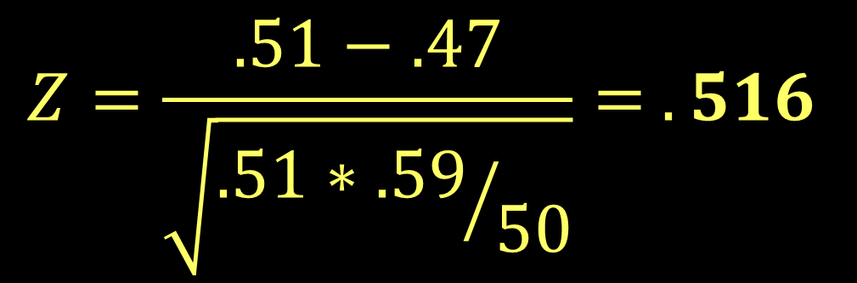
5) Calculate the test statistic
Our study finds that 51% of our sample (n=50) own dogs.

Slide 37

6) Make decision about the alternate/null hypotheses
Is the bulldog happy because Athens has more dogs than the national average?

Slide 38

Make decision about the alternate/null hypotheses
NO! The Z value of 0.516 does NOT reach our critical value of 1.645.
Therefore, the null hypothesis is NOT rejected. We cannot say with that dog ownership in Athens is greater than the national average with 95% confidence.

Slide 39
Do it on your own:
An economic geographer is studying income for geographers in Texas. According to census data, the mean income of Texas residents is $43,205. He surveys 63 geographers in the state and finds their average income is $53,530 (s.d.=$3,613). Can we say with 95% confidence that geographers have an income higher than the state average?
State the null and alternate hypothesis
Select appropriate statistical test
Select level of significance
Identify the rejection region of the null hypothesis
Calculate test statistic
Make decision regarding null and alternative hypothesis
Notes:
T statistic is 7.37. Critical value for 19 df is 2.09.

